Slide 1

Pattern Recognition
Chapter 4: Bayes Classifier
Chumphol Bunkhumpornpat
Department of Computer Science
Faculty of Science
Chiang Mai University

Slide 2
Learning Objectives
Be able to state the Bayes theorem
Be able to classify objects using naive Bayes classifiers
Be able to understand how Bayesian belief network

Slide 3
Bayes Classifier
Simple Probabilistic Classifier
Optimal Classifier
  It minimises the average probability of error.
Assumption
  Information about classes is in the form of prior probabilities.
  Distributions of patterns in the class are known.

Slide 4
Bayes Classifier (cont.)
It employs the posterior probabilities to assign the class label to a test pattern.
A pattern is assigned the label of the class that has the maximum posterior probability.
Bayes theorem converts the prior probability into posterior probability based on the pattern to be classified.

Slide 5
Bayes Theorem
X: Pattern whose class label is unknown
H_{i}: Hypothesis that X belongs to class C_{i}
P(H_{i}): Prior probability of H_{i}
  Known
  Obtained before observing X
P(H_{i} |X): Posterior probability of H_{i} conditioned on X
P(H_{i} |X) = P(X|H_{i}) × P(H_{i}) / P(X)

Slide 6
Example 1
In a coffee shop, 99% of the customers prefer coffee.
The remaining 1% prefer tea.
P(coffee drinker) = 0.99
P(tea drinker) = 0.01

Slide 7
Example 1 (cont.)
In the absence of any other information, we can classify any customer as a coffee drinker and the probability of error is only 0.01.
This is because we are classifying a tea drinker also as a coffee drinker.

Slide 8
Example 2
The prior probability of H that a road is wet is P(H) = 0.3.
The probability that a road is not wet is 0.7.
If we use only this information, then it is good to decide that a road is not wet.
The corresponding probability of error is 0.3.

Slide 9
Example 2 (cont.)
Probability of rain, P(X), is 0.3.
If it rains, we need to calculate the posterior probability that the roads are wet, i.e., P(H|X).
If 90% of the time when the roads are wet, it is because it has rained.
  P(X|H)
  P(it has rained | roads are wet)
P(road is wet|it has rained) =
P(X|H)×P(H) / P(X) = 0.9×0.3 / 0.3 = 0.9

Slide 10
Example 2 (cont.)
The probability of error is 0.1, which is the probability that a road is not wet given that it has rained.
Requirements
  P(H)
  P(X|H)
  P(X)

Slide 11
Classification Using Naive Bayes Classifier
Class-Conditionally Independent
It simplifies the computation (naive).
Comparable Performance
  Classification Trees
  Neural Network
Large Databases
  High Accuracy
  High Speed

Slide 12
Parameter Estimation
Class Priors and Feature Probability Distributions
Frequently-Based Probability Estimate
It incorporates a small-sample correction .
No probability is ever set to be zero.
To avoid this, a small value is taken.

Slide 13
Example 3
Total number of examples = 100
Number of examples of class 1 = 40
Number of examples of class 2 = 30
Number of examples of class 3 = 30
Prior probability of class 1 = 40/100 = 0.4
Prior probability of class 2 = 30/100 = 0.3
Prior probability of class 3 = 30/100 = 0.3

Slide 14
Example 3 (cont.)
Out of the 40 examples of Class 1, if a binary feature takes 0 in 30 examples and 1 in 10 examples, then the prior probability that this feature is 0 in this class will be 30/40 = 0.75.

Slide 15

Constructing a Classifier from the Probability Model
Bayes Probability Model and MAP Decision Rule
Most Probable Hypothesis
  Maximum Posterior
Function “classify”
  C: Class Variable
  f₁, …, f_{n}: n Feature Variables

Slide 16
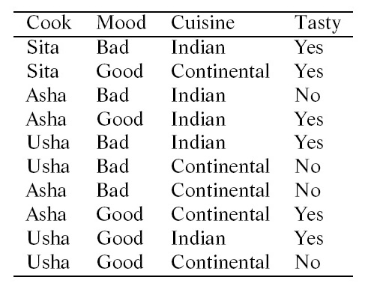
Example Training Data Set

Slide 17
Cook = Sita; Mood = Bad; Cuisine = Continental
P(Cook = Sita|Tasty = yes) = 2/6 = 0.33
P(Cook = Sita|Tasty = no) = 0/4 = 0 → 0.01
P(Mood = Bad|Tasty = yes) = 2/6 = 0.33
P(Mood = Bad|Tasty = no) = 3/4 = 0.75
P(Cuisine = Continental|Tasty = yes) = 2/6 = 0.33
P(Cuisine = Continental|Tasty = no) = 3/4 = 0.75

Slide 18
Cook = Sita; Mood = Bad; Cuisine = Continental (cont.)
P(Tasty = yes|X) = 0.6 × 0.33 × 0.33 × 0.33 = 0.0216
P(Tasty = no|X) = 0.4 × 0.01 × 0.75 × 0.75 = 0.00225
P(Tasty = yes|X) > P(Tasty = no|X)
X is classified as belonging to the class
Tasty = yes.

Slide 19
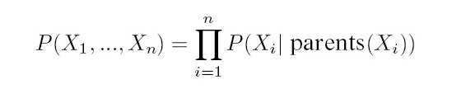
Bayesian Belief Network
Probabilistic Graphical Model (Directed Acyclic Graph)
  Sets of Variables (Nodes)
  Probabilistic Dependencies (Arcs)
Node A is a parent of Node B if there is an arc from A to B.
Parent(X_{i}): Set of parent nodes of a node X_{i}

Slide 20
Example 4
Ram is a student. He loves going to the movies. He will go to the theatre in the evening if he has money in his pocket. On the other hand, if it rains, he will not go the theatre. When Ram does not go to the movies, he stays home and watches the television. He also dedicates some time to his studies.

Slide 21
The variables involved are
M: Money in Ram’s Pocket
R: Rain
S: Ram Studies
T: Ram watches television.
G: Ram goes to the movies.
M and R are not influenced by any factor.
S and T are influenced by G.

Slide 22
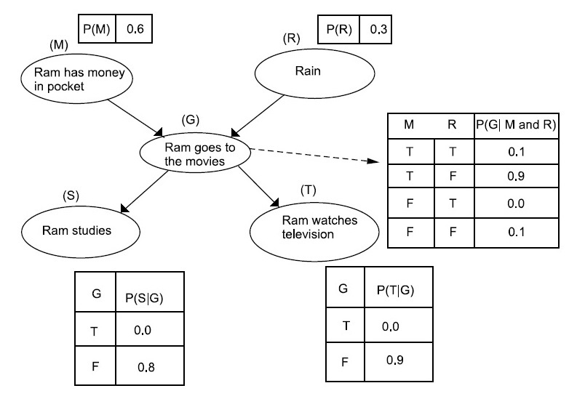
Belief Network of
How Ram Spends an Evening

Slide 23
Example 4 (cont.)
Let ¬A stand for negation of the preposition A.
The probability that it does not rain, Ram does not have money, Ram goes to the movies and Ram does not watch television
  P(¬R, ¬M, G, ¬T)
  P(¬R) × P(¬M) × P(G|¬R and ¬M) × P(¬T|G)
  0.7 × 0.4 × 0.1 × 1.0 = 0.028

Slide 24
Reference
Murty, M. N., Devi, V. S.: Pattern Recognition: An Algorithmic Approach (Undergraduate Topics in Computer Science). Springer (2012)

